Slide 1
Part three
Mechanism
第 三 章
Introducing main elements and mehcanism in our game.

Slide 2
01
02
Agents
Environment
Forests
Mountains
Caves
……
Stork
Demons

Slide 3
Stock
Move forward
Forward
Speed
01
A
B
02
Move backward
03
Increase height
Movement
04
Decrease height
05
Turn left
06
Turn right
07
Combined movement

Slide 4
Stock
100%
Energy Status
Can accelerate and use fighting skill 2

Slide 5
Stock
80%
Energy Status
Can accelerate and use fighting skill 1

Slide 6
Stock
50%
Energy Status
Can use fighting skill 1

Slide 7
Stock
30%
Energy Status
Can only move with normal speed

Slide 8
Stock
0%
Energy Status
Drop the baby and fail

Slide 9
Demons
Movement
Move in a limited area
Normal
Status
Fighting
Dead

Slide 10
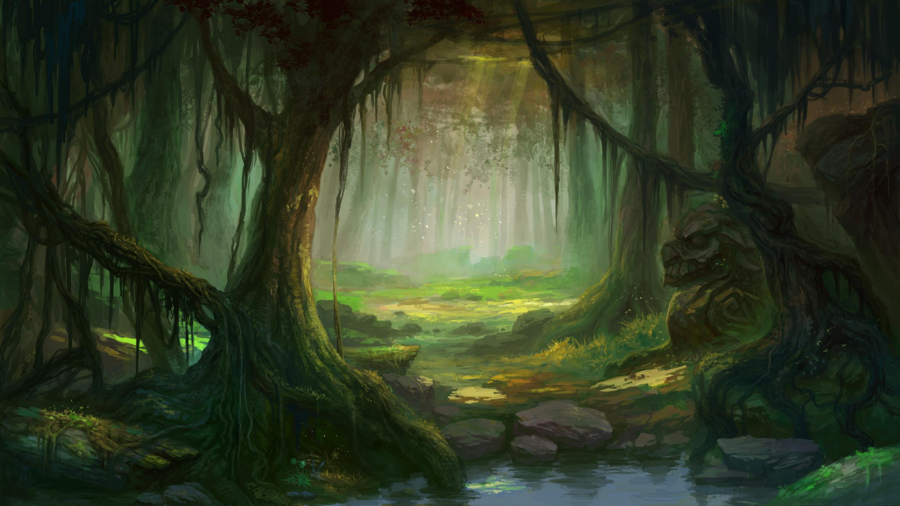
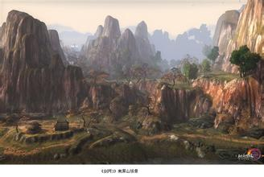
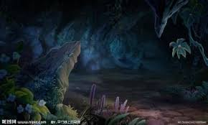
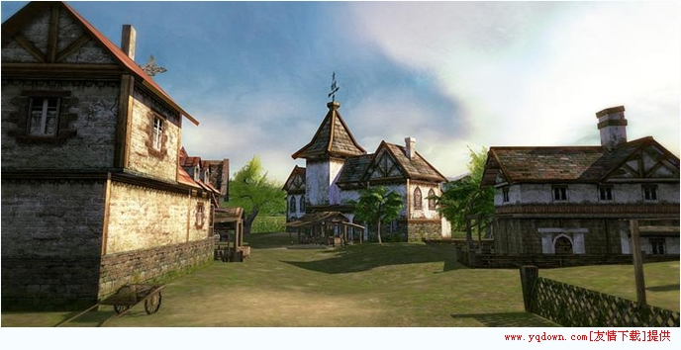
Environment
In different stories we have different environments
……

